Slide 1

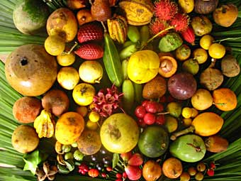

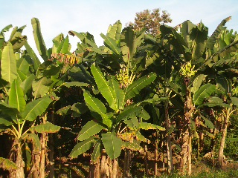
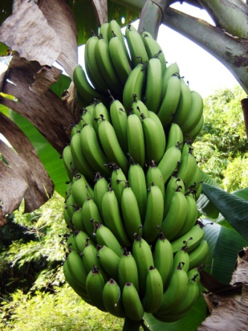

FORO INTERNACIONAL del BANANO 2011
The issues of financial, food, water and energy security - their impact on the demand and consumption of bananas and fruit with particular reference to European markets.
Professor John Moverley OBE FRAgS
Chairman ,Azurance , UK

Slide 2


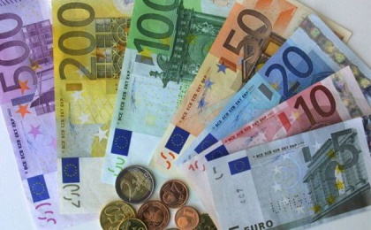

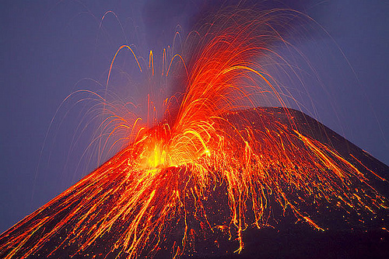
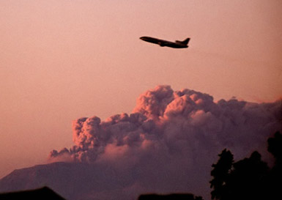

FLYING HAS RESUMED BUT THE IMPACT OF THE ECONOMIC CRISIS GOES ON

Slide 3

SOME OF THE IMPACTS OF THE FINANCIAL SITUATION IN EUROPE
Greater emphasis on efficiency and effectiveness in purchasing
Greater emphasis on food production from own resources
Changing consumer purchasing habits and styles
The impact in Europe is not uniform

Slide 4

RETAIL FIGURES FOR EUROPE – COMPARISON DECEMBER 2010 TO DECEMBER 2009
(Eurostat Figures)
Volume of retail sales fell by 0.6% in Euro area and 0.4% in European 27
Total food, tobacco and drink sales fell by 1.1% in Euro area and 1.2% in European 27
Greatest falls in Malta, Rumania and Spain
Increases in Poland, Latvia and Estonia
understanding your market, as always, is important

Slide 5

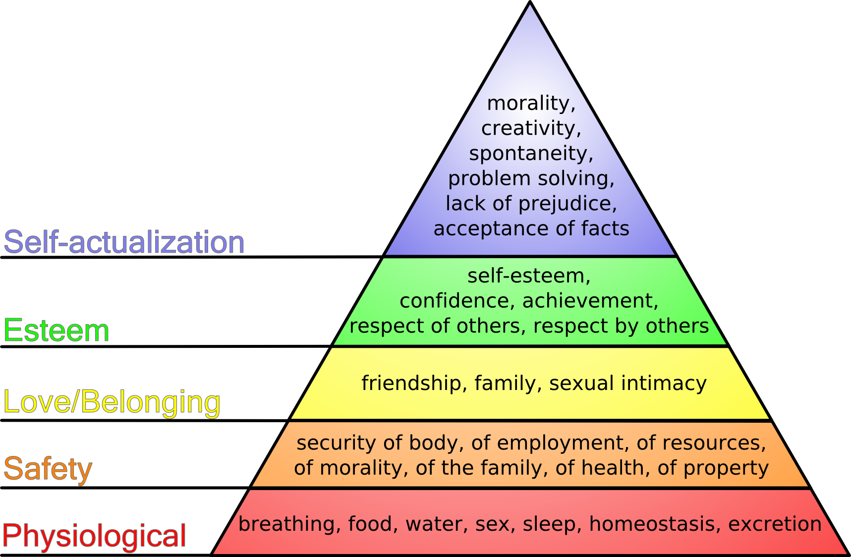
MASLOW TRIANGLE OF NEEDS (1943)
security of the supply of food, water and energy

Slide 6

SECURITY ISSUES
FOOD
ENERGY
WATER
FINANCIAL
POLITICAL
and more

Slide 10
Introduction
We live in interesting times & rapidly changing times
TIMELINE
Oil price rises – cost increases/ inflation
Re-emergence of the food security issue
A changing world – dietary, population
A Financial Crisis
Supermarket Banana Wars
Trade Agreement
Impact of currency rates & higher oil prices

Slide 11
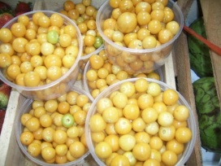
Introduction
We live in interesting times
CUSTOMER RESPONSE
Trading down
Price cutting on staple items – value lines
Unemployment & Insecurity
Cut back on recognised luxuries
New luxuries – certain food items
Food stayed relatively recession proof but some signs of change

Slide 12
So what does this mean for bananas? My presentation split into 4 main parts:
Issues of demand & supply for food
Consumption and Demand for Bananas
  Some live data for a UK supermarket
Banana Prices – interesting times!
Some issues & concluding thoughts

Slide 13
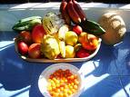
How recession proof are the drivers?
Demand pull
  (i) Population
  (ii) Dietary shift
  (iii) Policy changes
Supply Constraints
  (v) Land – finite supply & competing demands
  (vi) Climate Change & Water
  (viii) Technology restraints

Slide 14
Population Growth & Food Security
World food demand could double by 2050
  50% increase from world population growth all in developing countries
  50% increase from successful poverty reduction – development = food demand
Food Security?
  850 million people were chronically hungry before the food crisis of 2007 (UN)
  1 billion people are the current number of chronically hungry (FAO)
Financial Crisis or Food Crisis?

Slide 15
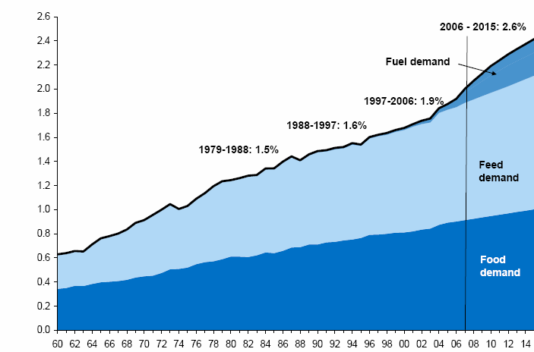
Impact of Biofuels on Demand
Demand for Food, Feed & Biofuel
billion metric tons
Source: Goldman Sachs Commodities Research

Slide 16
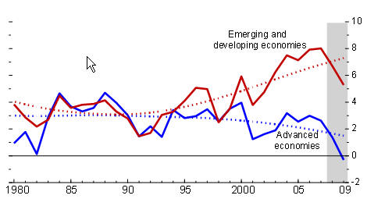
Real GDP Growth and Trend
Source: IMF

Slide 17
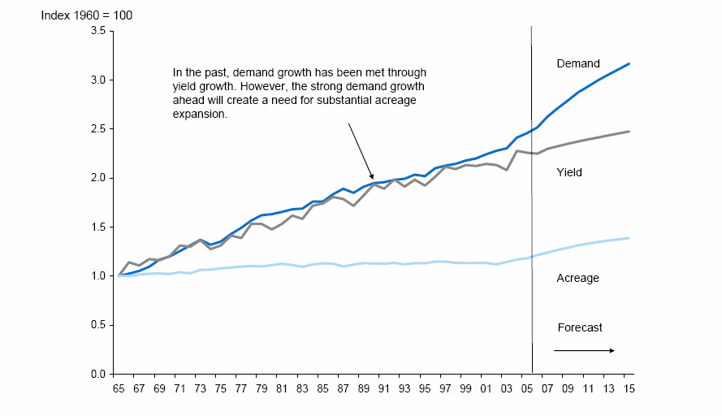
Production
Yield Relative to Demand
Source: FAO Food Price Index, USDA, Goldman Sachs Commodities Research

Slide 18
Commodities & Agriculture: Just how ‘recession proof’ – what can history tell us?

Slide 19

Global Consumption and Demand of Bananas and Fresh Fruit

Slide 20
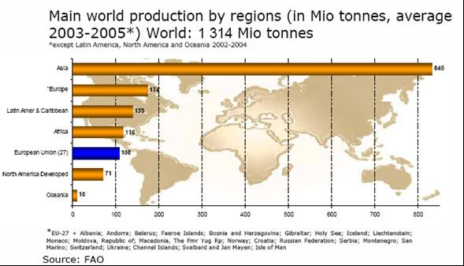
Global Production of Fresh Fruit

Slide 21
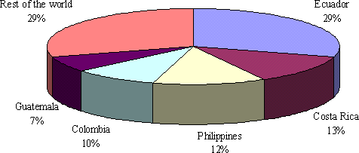
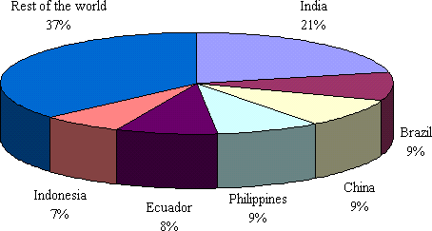
Global Banana Production and Consumption 2003-2007
Exports
Production

Slide 22
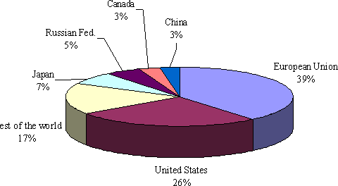
Global Banana Production Import Averages 2002- 2006

Slide 23
Global Consumption and Demand of Bananas and Fresh Fruit

Slide 24
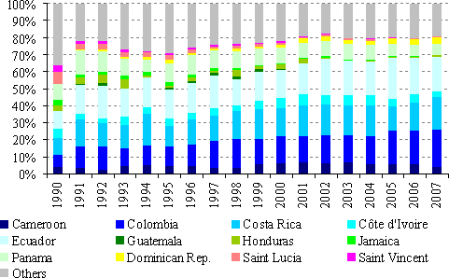
Geographical distribution of bananas imported in the European Union, 1990-2007
Source: UNCTAD Secretariat from COMTRADE statistics

Slide 25
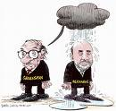
Recession and Bananas: What does Economic theory tell us?
Income Elasticity of Bananas in Europe =0.6
A measure of responsiveness of demand for a good to change in income of people
Price Elasticity of Demand = 0.4
A measure of how responsive the demand is to price change

Slide 26
Recession and Bananas: What does History tell us?

Slide 27
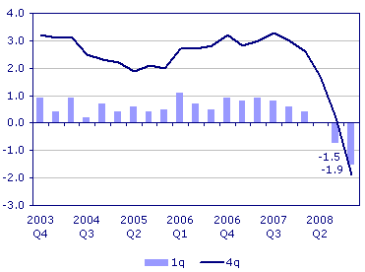
The UK Position: GDP
Source: UK Office of National Statistics

Slide 28
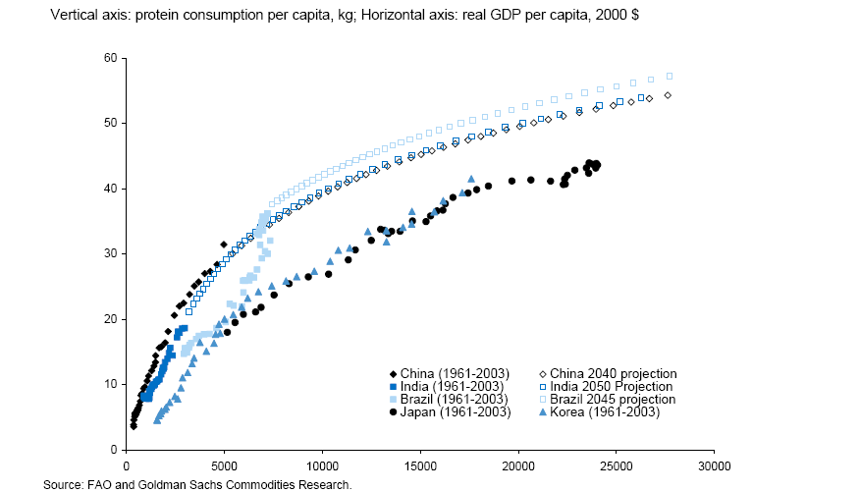
Dietary Shift

